Slide 1


Node.js
An event-driven,
non-blocking I/O model
Notes:
© SUPINFO International University - http://www.supinfo.com
SUPINFO vous permet de partager ce document
Vous êtes libre de :
Partager — reproduire, distribuer et communiquer ce document Remixer — modifier ce document
A condition de respecter les règles suivantes :
Indication obligatoire de la paternité — Vous devez obligatoirement préciser l’origine « SUPINFO » du document au début de celui-ci de la même manière qu’indiqué par SUPINFO International University – Notamment en laissant obligatoirement la première et la dernière page du document, mais pas d'une manière qui suggérerait que SUPINFO International University vous soutiennent ou approuvent votre utilisation du document, surtout si vous le modifiez. Dans ce dernier cas, il vous faudra obligatoirement supprimer le texte « SUPINFO Official Document » en tête de page et préciser notamment la page indiquant votre identité et les modifications principales apportées.
En dehors de ces dispositions, aucune autre modification de la première et de la dernière page du document n’est autorisée.
NOTE IMPORTANTE : Ce document est mis à disposition selon le contrat CC-BY-NC-SA Creative Commons disponible en ligne http://creativecommons.org/licenses ou par courrier postal à Creative Commons, 171 Second Street, Suite 300, San Francisco, California 94105, USA modifié en ce sens que la première et la dernière page du document ne peuvent être supprimées en cas de reproduction, distribution, communication ou modification. Vous pouvez donc reproduire, remixer, arranger et adapter ce document à des fins non commerciales tant que vous respectez les règles de paternité et que les nouveaux documents sont protégés selon des termes identiques. Les autorisations au-delà du champ de cette licence peuvent être obtenues à support@supinfo.com.
© SUPINFO International University – EDUCINVEST - Rue Ducale, 29 - 1000 Brussels Belgium . www.supinfo.com

Slide 2

Node.js
Course objectives
By completing this course, you will be able to:
Explain what NodeJS is and what it’s not
Use it to create a JavaScript server
Develop a complete application

Slide 3


Node.js
Course topics
Course’s plan:
What is this node?
TCP server
Implementing a Web socket server
Develop a complete application with Express and MongoDB

Slide 4
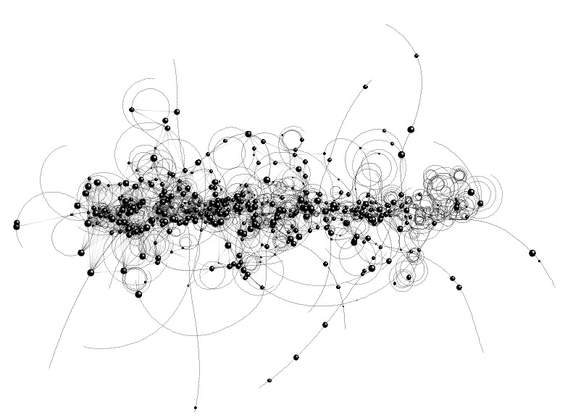
What is this node ?
Node.js

Slide 5

Introduction
From the browser to the server
Some time ago, JavaScript lived mainly in browsers
Node.js is a new context granting JavaScript as a server-side language too

Slide 6
Introduction
V8 Runtime
Node.js is built on the V8 JavaScript engine
Developed by Google and used by Chrome
Fast: Compiles JavaScript to native machine code
Open Source
Node.js
V8 JavaScript Runtime

Slide 7
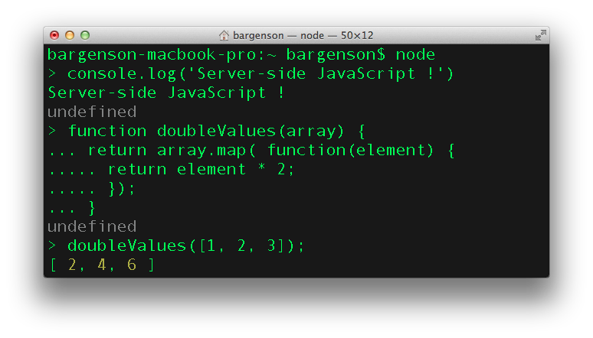
Introduction
Node.js environment

Slide 8
Introduction
Real Time Web
Node.js is designed for writing scalable Internet applications !
Event-driven and asynchronous I/O model
Minimize overhead and maximize scalability

Slide 9
Introduction
Blocking VS non-blocking
Imagine the following program :
In that example, the program is blocked until the DB return the query result
It is called a blocking I/O operation
Retrieve all the articles from a Database
Display them
Do something else…

Slide 10
Introduction
Blocking VS non-blocking
Now, look at the the following version :
In that example, only the second instruction will wait the first one to finish
The second instruction is called callback
Retrieve all the articles from a Database
When complete, display them
Do something else…

Slide 11
Introduction
Blocking VS non-blocking
Why non-blocking model is better ?
Blocking
Instruction 1
Wait…
Instr 2
Instr 3
Non-blocking
Instruction 1
Instr 3
Instr 2

Slide 12
Introduction
Blocking VS non-blocking
Node.js libraries are designed to be non-blocking
But some blocking version are available too
fs.readFile(‘myFile.csv’, function(err, contents) {
console.log(contents);
});
console.log('Do something else…');
var contents = fs.readFileSync(‘myFile.csv’); console.log(contents);
console.log('Do something else…');

Slide 13
Introduction
Why JavaScript ?
“JavaScript has certain characteristics that make it very different than other dynamic languages, namely that it has no concept of threads. Its model of concurrency is completely based around events.”
- Ryan Dahl, creator of Node.js
Notes:
http://dailyjs.com/2010/08/10/ryan-dahl-interview/

Slide 14
Introduction
CommonJS
Node.js implements CommonJS specification
Libraries are just CommonJS modules
And you already know
How to use them
How to create your owns

Slide 15
Introduction
Node.js is not…
A Web Framework
Don’t compare it to Rails, Django or other
Node is very low level
Multi-threaded
Think of it as a single threaded server

Slide 16


Questions ?

Slide 17


HTTP Server
Node.js

Slide 18
Introduction
HTTP module
To create an HTTP Server, Node.js provides the HTTP module
var http = require('http');
http.createServer( function(req, res) {
res.writeHead(200, { 'Content-Type': 'text/plain' });
res.write('Hello world');
res.end();
}).listen(1337);
console.log('Server running on port 1337');

Slide 19
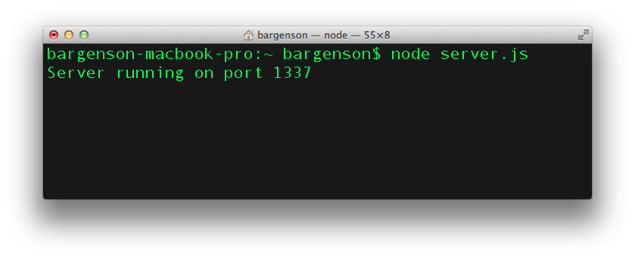
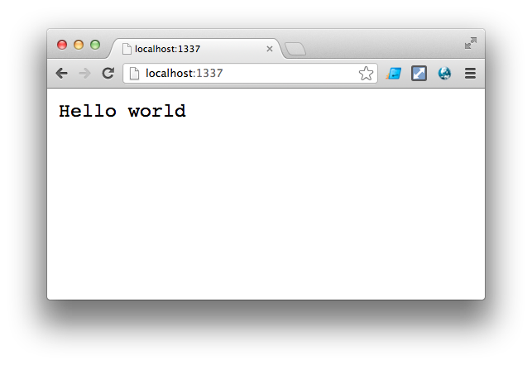
Introduction
HTTP module

Slide 20
Introduction
http.Server
http.createServer([requestListener])
Create a new web server object
The function passed in argument handle client requests
http.createServer( function(request, response) {
...
});

Slide 21
Introduction
http.ServerRequest
Object created internally by a HTTP server
Represent a client request
Passed as the first argument to a request listener
http.createServer( function(request, response) {
...
});

Slide 22
Introduction
http.ServerRequest
http.createServer( function(request, response) {
// Request URL string (e.g. '/status?name=ryan')
console.log(request.url);
// The request method (e.g. 'GET')
console.log(request.method);
// Request headers looking like follow:
// { 'user-agent': 'curl/7.22.0',
// host: '127.0.0.1:8000',
// accept: '*/*' }
console.log(request.headers);
});

Slide 23
Introduction
http.ServerRequest
http.createServer( function(request, response) {
if (request.method == 'POST') {
var requestBody = '';
request.on('data', function (data) {
requestBody += data;
});
request.on('end', function () {
console.log(requestBody);
// Do something with request body
});
}
});

Slide 24
Introduction
http.ServerResponse
Object created internally by a HTTP server
Represent a response that will be send to a client
Passed as the 2nd argument to a request listener
http.createServer( function(request, response) {
...
});

Slide 25
Introduction
http.ServerResponse
http.createServer( function(request, response) {
// Specify HTTP status code and HTTP headers
response.writeHead(200, {'Content-Type': 'text/plain'});
// Sends a chunk of the response body
response.write('Hello');
// Signals to the server that all of
// the response headers and body have been sent
response.end(' world! ');
});

Slide 26
Questions ?

Slide 27

TCP Server
Node.js

Slide 28
Introduction
Net module
To create a TCP Server, Node.js provides the Net module
var net = require('net');
var server = net.createServer( function(socket) {
socket.on('end', function() {
console.log('Client disconnected');
});
socket.write('Echo server\r\n');
socket.pipe(socket);
});
server.listen(1337);

Slide 29
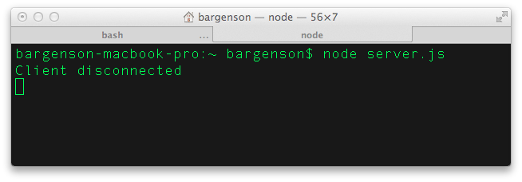
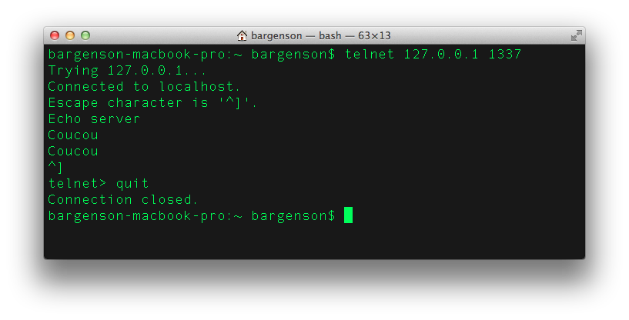
Introduction
Net module

Slide 30
Introduction
net.Server
net.createServer([requestListener])
Create a new TCP server object
The function passed in argument handle new socket connections
net.createServer( function(socket) {
...
});

Slide 31
Introduction
net.Socket
Object representing a TCP socket
Can be created by the user and used as a client
net.createServer( function(socket) {
...
});

Slide 32
Introduction
net.Socket
var socket = net.createConnection(1337, 'localhost');
// Event ‘data’ handler
socket.on('data', function(data) { console.log(data); });
// Event ‘end’ handler
socket.on('end', function() { console.log('End'); });
// Sends data on the socket
socket.write('Message');
// Half-closes the socket
socket.end();

Slide 33
Questions ?

Slide 34

Implementing a web socket Server
Node.js

Slide 35
Introduction
Node Packaged Modules
npm is a package manager for Node.js
Manage dependencies for an application
Deployed and installed automatically with node environment
Notes:
https://npmjs.org/

Slide 36
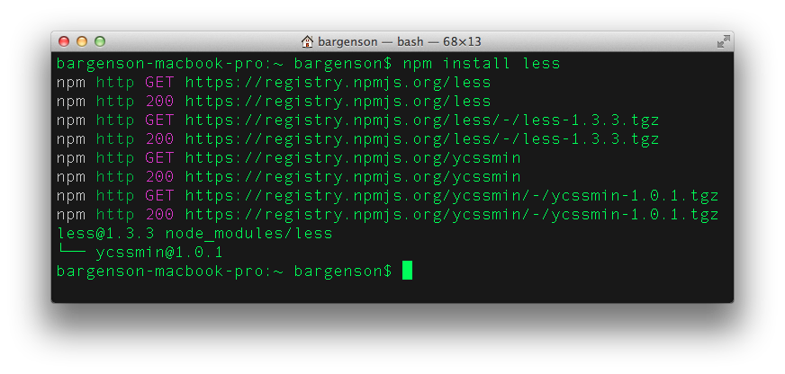
Introduction
Node Packaged Modules

Slide 37

Introduction
A WebSocket module
For this course, we gonna install and use the following module :
https://github.com/Worlize/WebSocket-Node
It’s a pure JavaScript implementation of the WebSocket protocol
Notes:
https://npmjs.org/

Slide 38
Introduction
Exercise
You already know how to use WebSocket from client-side
Create a simple Chat application with Node.js and the module we’ve just seen in the previous slide
Notes:
https://npmjs.org/

Slide 39
Questions ?

Slide 40

Socket.io
Node.js

Slide 41
Introduction
What is Socket.IO ?
Socket.IO aims to make realtime apps possible in every browser and mobile device
Blur the differences between the different transport mechanisms
Notes:
https://npmjs.org/

Slide 42
Introduction
What is Socket.IO ?
A unique API for realtime applications using in function of the browser compatibility :
WebSocket protocol
Adobe Flash sockets
JSONP polling
AJAX long polling
Notes:
https://npmjs.org/

Slide 43
Introduction
Simple Example
io.sockets.on('connection', function (socket) {
socket.emit('news', { hello: 'world' });
socket.on('my other event', function (data) {
console.log(data);
});
});
NodeJS code
<script src="/socket.io/socket.io.js"></script>
<script>
var socket = io.connect('http://localhost');
socket.on('news', function (data) {
console.log(data);
socket.emit('my other event', { my: 'data' });
});
</script>
Client code
Notes:
https://npmjs.org/

Slide 44
Questions ?

Slide 45

Develop a complete application With express and MongoDB
Node.js

Slide 46
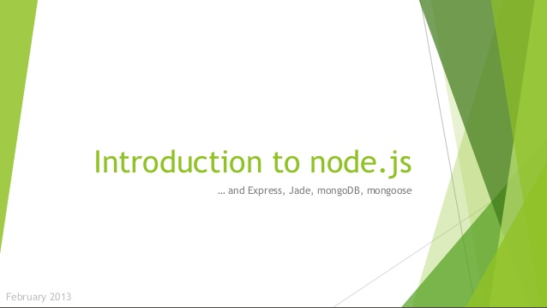
Introduction
External slides
Got to Slideshare :
http://fr.slideshare.net/adriengueret/introduction-to-nodejs-16790822
Notes:
https://npmjs.org/

Slide 47
Questions ?

Slide 48


